Slide 1
Integrating Sensors and Devices:
Ctrl+Alt+Elite

Slide 2
Integrating Sensors and Devices
We will learn about:
Infrared Sensors
Ultrasonic Sensors
Color Sensors
Servos
MOSFETs

Slide 3
Infrared Sensors
Infrared sensors are used to detect the presence of objects by emitting their own IR radiation forward and then measuring the amount reflected back.
The IR signals are mainly used for transmitting commands over the air on short distances (typically few meters) like what you’ve already worked with on TV remote controls or other similar electronic devices.
IR Sensor Module can be widely used in robot obstacle avoidance, obstacle avoidance car, line count, and black and white line tracking.

Slide 4
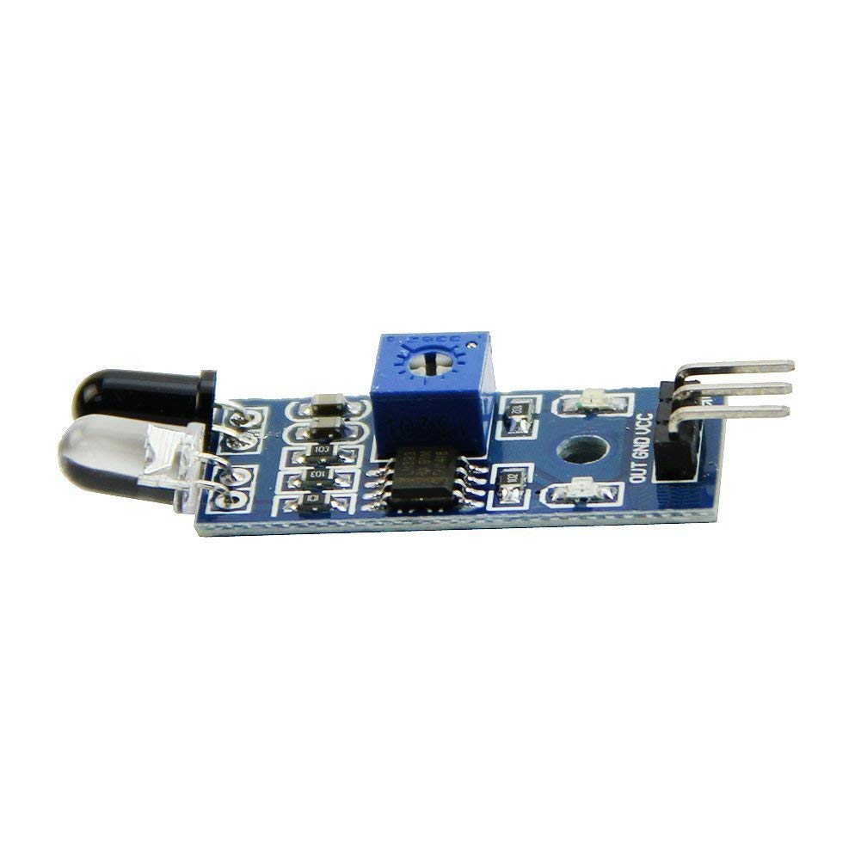
Infrared Sensor
GND: Ground
VCC: voltage at the common collector, it’s supply voltage from negative to positive.
SIG: Signal that detect motion
in the environment and report to
arduino.

Slide 5
Infrared Sensors
Using an IR sensor and an LED, make a circuit and code that lights up the LED when something is close to the IR sensor.
Notes:
Have the kids provide the instructions on how to solve the problem, but you write them down, in English. (We’re creating pseudocode.)
Then, once the pseudocode is done, show the kids how to translate it to actual code.
Now move to the next slide to let them write up the code on their own and wire up the circuit.

Slide 6
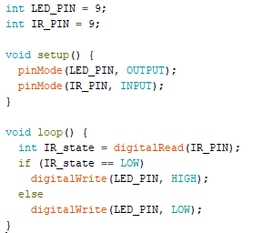
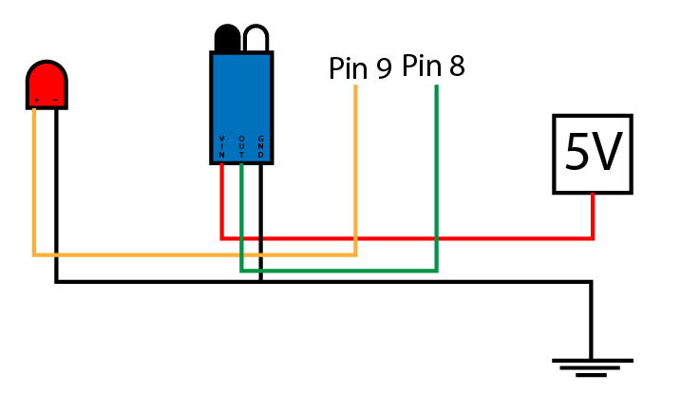
Infrared Sensors
8
Notes:
Only spend 5-10 minutes on this slide, letting the students copy the code and figuring out the wiring.

Slide 7
Ultrasonic Sensor
DISTANCE
ECHO
TRIGGER
Sensor triggers sound-wave that bounces off an object
Receives the bounced sound-wave

Slide 8
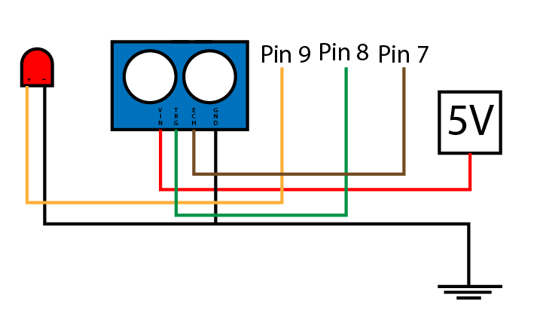
Ultrasonic Sensor
4 pins:
Vin = the power pin
GND = ground
TRG = trigger pin (digitalWrite)
ECH = echo pin (digitalRead)
(5V)

Slide 9
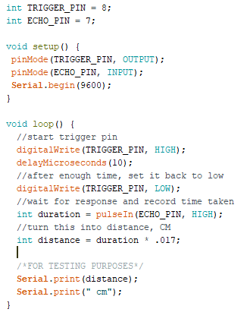
Ultrasonic Sensor
Notice: TRIGGER_PIN is OUTPUT ECHO_PIN is INPUT
You are “shooting” (HIGH) the waves from TRIGGER_PIN for 10 microseconds, then stop (LOW)
pulseIn: measures how long it took for the sound to come back (returns microseconds)
Notes:
To convert ‘duration’ (which is in microseconds) to centimeter, ‘distance’, we use the speed of sound being approximate 340m/s. Since, ‘duration’ is in microseconds we divide 340m/s by 10^6, and then multiply by 10^3 to convert meter to centimeters. Thus, we got 0.034 cm/us since we are interested only in half of the distance the sound traveled divide it by 2 => 0.017. Green line because the kids do not need to know the math behind it.

Slide 10
A Challenge
Using an Ultrasonic sensor and an LED, make a circuit and code that makes the LED dimmer as something is closer to the sensor.
Hint:
analogWrite() can be between 0 to 255
Notes:
For this challenge, have the students write some pseudocode and translate on their own. If/when they ask for help, make sure they have pseudocode before they are trying to create actual code.
Spend the last 10-15 minutes of the “class” working out the solution with them. Create pseudocode as a class, and then have them help with the translations.

Slide 11
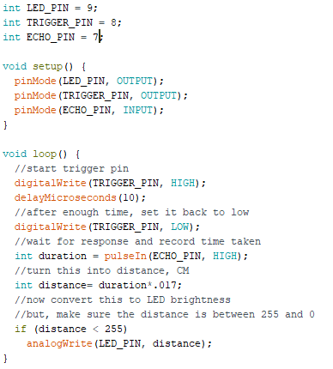
A Solution

Slide 12
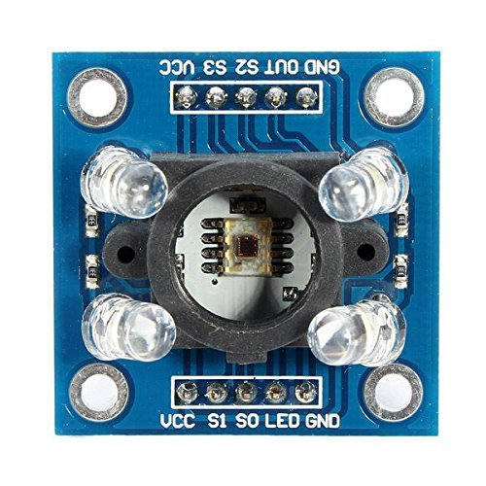
Color Sensors
This is a color sensing module
It can be used to detect different colors and report that back to the arduino

Slide 13
Color Sensors
This color sensor has a total of 10 pins.
Two VCC pins
Power in
You only need to use one at a time
It has two ground pins
Only one is needed.

Slide 14
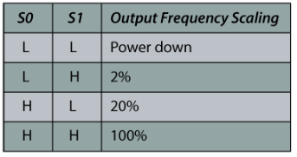
The Color Sensor
Four control pins
S0-S3
S0 and S1
They control the strength of the signal the sensor sends back to the arduino.
Notes:
https://howtomechatronics.com/tutorials/arduino/arduino-color-sensing-tutorial-tcs230-tcs3200-color-sensor/
Source for chart

Slide 15
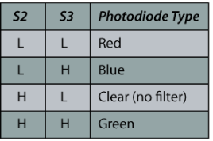
The Color Sensor
Four control pins
S0-S3
S2 and S3
These control what color you are looking at
The sensor can only see one color at a time, or all of them at once.
Notes:
So, it can see only red, only green, only blue, or all of them, but not red and green at the same time (without blue), and so on.
https://howtomechatronics.com/tutorials/arduino/arduino-color-sensing-tutorial-tcs230-tcs3200-color-sensor/
Source for chart

Slide 16
Using Serial Monitor & Color Sensor
With the color sensor wired up, and an understanding of the serial monitor, now we can read the color values, and print them out.
We will start with the clear filter, at output 20%
We will need digitalWrite, Serial.begin, Serial.print, and pulseIn

Slide 17
Using Serial Monitor & Color Sensor
Now, lets try reading and printing the three color readings!
We will need digitalWrite, Serial.begin, Serial.print, and pulseIn
Notes:
They may need to be walked through this.

Slide 18
Using the color sensor with RGB LED’s
Using the color sensor, an arduino, and a RGB LED, make the LED change colors to match as close as reasonable.
You will need
Serial.begin(9600);
Serial.print(“[text]”);
digitalWrite([pin number],[HIGH/LOW]);
pulseIn([pin], LOW);
map([value], [value-low],[value-high],[final low],[final high]);
analogWrite([pin],[a value between 0 and 255]);
Notes:
We will need to walk them through the logic

Slide 19
The Color Sensor (cont.)
As it happens, there is a library that will let us use the color sensor more easily
A library is a premade piece of code that you have to import into your project.
#include “[Name]” or #include <[Name]>
in this case, #include “TCS3200.h”
you need to make sure that the files you need are in your project folder.

Slide 20
Using the Library
After you import the library, using the color sensor becomes much easier!
First, you must declare a variable of type TCS3200
That’s the type of color sensor we are using
How would you do this?

Slide 21
Using the Library
After you import the library, using the color sensor becomes much easier!
First, you must declare a variable of type TCS3200
That’s the type of color sensor we are using
How would you do this?
TCS3200 [name] = TCS3200([s0],[s1],[s2],[s3])
OUT has to be on pin 2
You get to pick the name.
You also need an array, think of it like a list of values
uint8_t colors[3]
this will hold the readings from the color sensor.

Slide 22
Using the Library
After you declare the color sensor, you have to start it reading!
you do this with a familiar command
[name of color sensor].begin();
almost like Serial.begin();
after that, you call [name].loop(); inside the loop function.
then you use [name].getRGB(colors)
this saves the colors in the array
red is colors[0], green is colors[1], blue is colors[2]

Slide 23
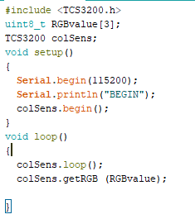
An Example
Note: When wired up, OUT must be on pin 2.

Slide 24
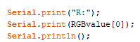
Now, let’s use this to print values
Use what we have taught you to read in, and print all three colors.
To the side is an example on how to print from an array

Slide 25
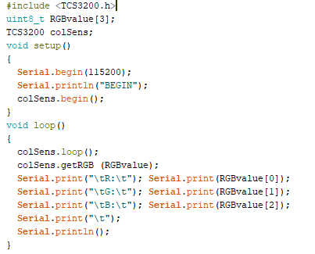
Solution

Slide 26
The sensors output
What range of values was the sensor reading?

Slide 27
The sensors output
What range of values was the sensor reading?
0-255
Does that seem familiar?
Where else does it show up?

Slide 28
The sensors output
What range of values was the sensor reading?
0-255
Does that seem familiar?
Where else does it show up?
It appears in analogWrites!

Slide 29
The sensors output
What range of values was the sensor reading?
0-255
Does that seem familiar?
Where else does it show up?
It appears in analogWrites!
How does analogWrite work?

Slide 30
The sensors output
What range of values was the sensor reading?
0-255
Does that seem familiar?
Where else does it show up?
It appears in analogWrites!
How does analogWrite work?
analogWrite([pin number], [0-255]);

Slide 31
Another challenge
Using what we know let's map the output of the color sensor to an RGB LED
I hope you took notes, because you don't get hints this time.

Slide 32
Color ranges
Hold up different colors to the senor, and record what color and the readings it gave.

Slide 33
Color ranges
Write some code, using if statements, to print what color is being seen at any given time, either Red, Green, or Blue

Slide 34
colors expanded
Now, expand that last example to “see” at least six colors.

Slide 35
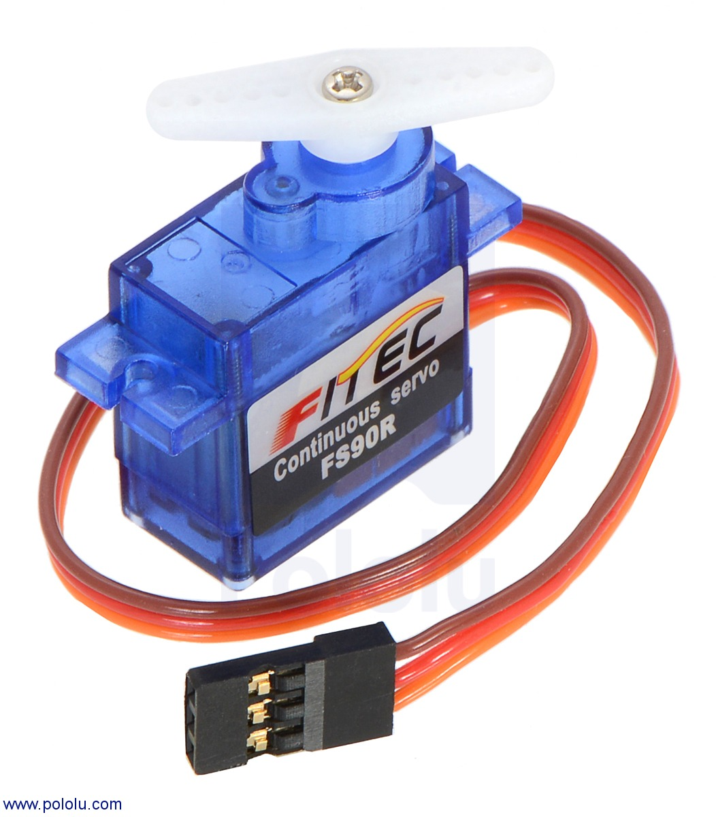
Servos
A servo is a motor that rotates, and knows where in that rotation it is.

Slide 36
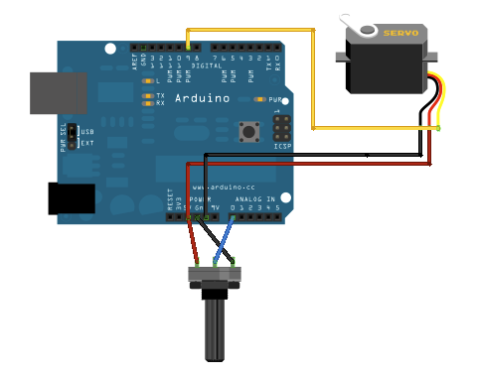
How to Wire a Servo
Notes:
https://www.arduino.cc/en/Tutorial/Knob

Slide 37
How do we control this?
We use the Servo library
#include <Servo.h>
We place this at the top of our file.
We also have to declare a Servo
Tells the arduino that it has one attached
Servo [name of servo];
We attach it
servoName.attach([pin servo is attached to]);
and finally, now we can control it
servoName.write([a value between 0 and 180]);

Slide 38
Now let's use it!
Using a servo and a potentiometer, make the servo turn when the potentiometer is.
What functions do you think we will need?
Notes:
Have the students try to remember what functions they need
analogread
write
delay
also introduce Map

Slide 39
Solution
#include <Servo.h>
Servo myservo; // create servo object to control a servo
int inputPin = A0; // analog pin used to connect the potentiometer
int val; // variable to read the value from the analog pin
void setup() {
myservo.attach(9); // attaches the servo on pin 9 to the servo object
}
void loop() {
val = analogRead(inputPin); // reads the value of the potentiometer (value between 0 and 1023)
val = map(val, 0, 1023, 0, 180); // scale it to use it with the servo (value between 0 and 180)
myservo.write(val); // sets the servo position according to the scaled value
delay(15); // waits for the servo to get there
}
Notes:
https://www.arduino.cc/en/Tutorial/Knob

Slide 40
MOSFETs
A MOSFET (Metal Oxide Semiconductor Field Effect Transistor) transistor is a semiconductor device which is widely used for switching and amplifying electronic signals in the electronic devices.
A MOSFET works by electronically varying the width of a channel along which charge carriers flow (electrons or holes). The charge carriers enter the channel at source and exit via the drain. The width of the channel is controlled by the voltage on an electrode is called gate which is located between source and drain.

Slide 41
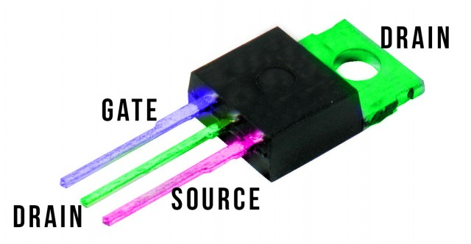
MOSFETs
MOSFETs can be used :
As an amplifier to increase the signal in a circuit
For voltage regulator circuits
For a chopper circuit
That is an electronic switch that is used to interrupt one signal under the control of another.
Can be found in battery chargers
Notes:
Picture Source: https://oscarliang.com/ctt/uploads/2013/10/mosfet.jpg

Slide 42
Additional Challenges

Slide 43
A Challenge
Using an Ultrasonic sensor and an LED, make a circuit and code that makes the LED dimmer as something is closer to the sensor.
Notes:
For this challenge, have the students write some pseudocode and translate on their own. If/when they ask for help, make sure they have pseudocode before they are trying to create actual code.
Only spend 5-10 minutes on this. Then spend the next 10ish minutes working out the solution with them. Create pseudocode as a class again, and then have them help with the translations.
Didn’t make it this far for the day these slides were used.

Slide 44
A Solution

Slide 45
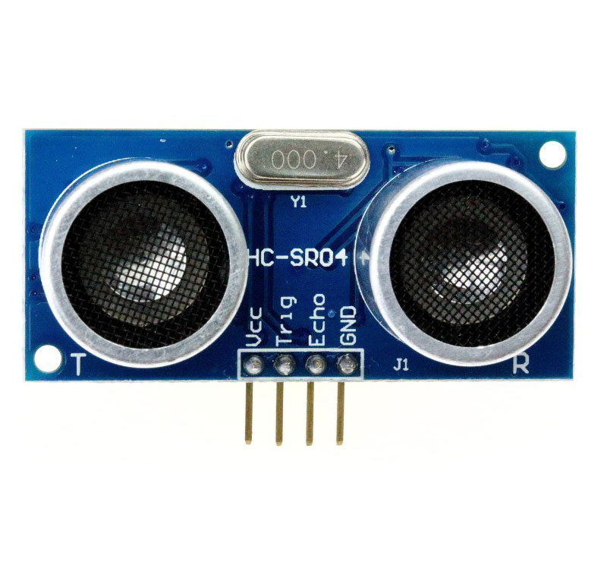
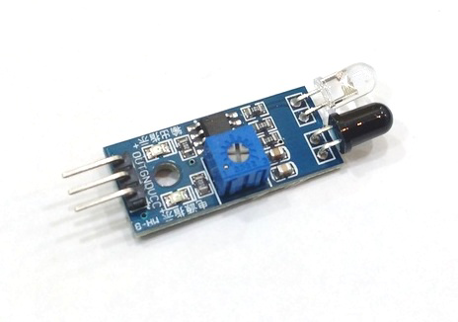
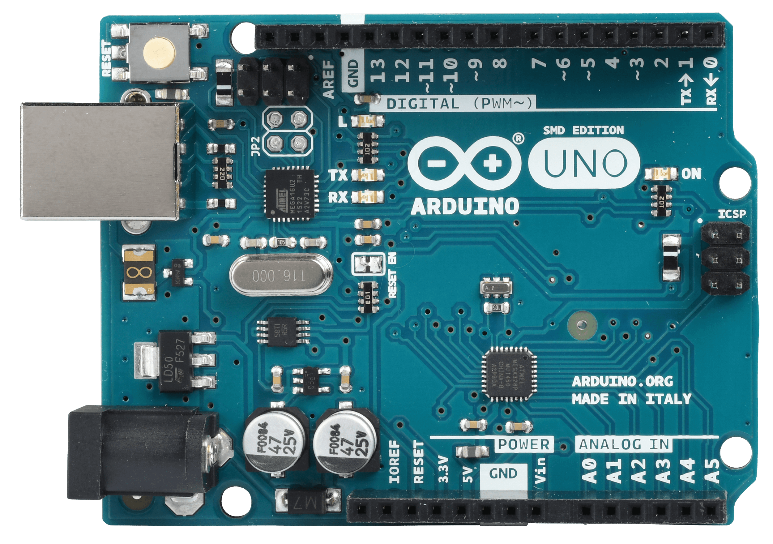
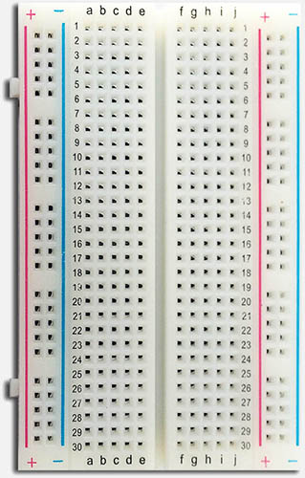
Build this circuit

Slide 46
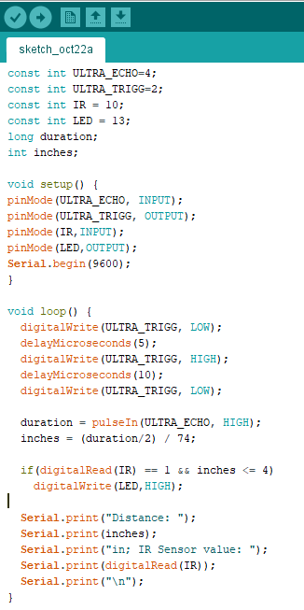
Triggers the sound wave out of the sensor

